Slide 1
Introduction to Neural Networks
Jul 27, 2023
Thu 4 PM
Introduction to Artificial Intelligence - 2023 Summer
Kwangwoon University MI:RU
Artificial Intelligence Study

Slide 2
Agenda
In this course, you will learn
Part 1 – Quick Review of Partial Derivation and Chain Rule
Part 2 – Perceptron & Artificial Neuron Networks
Part 3 – Linear Regression & Backpropagation
Part 4 – Recurrent Neural Networks (RNN)

Slide 3
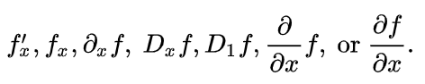
Quick review of Partial Derivative and Chain Rule
Partial derivative
Notation for Partial derivative of variable x

Slide 4
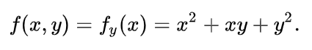
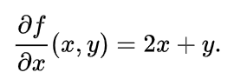
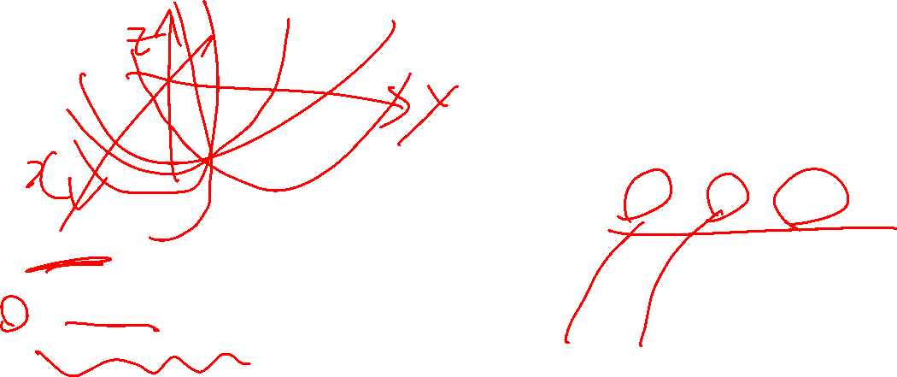
Quick review of Partial Derivative and Chain Rule
Partial derivative
What we want to know
Change rate of ONLY x
Then, handle y as a constant
=> We can get the change rate of x ONLY!
Handle y as a constant
=> Then, y will be eliminated

Slide 5
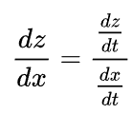
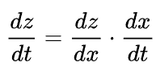
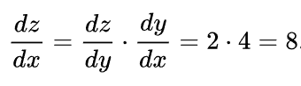
Quick review of Partial Derivative and Chain Rule
Chain Rule
Chain rule
OR

Slide 6
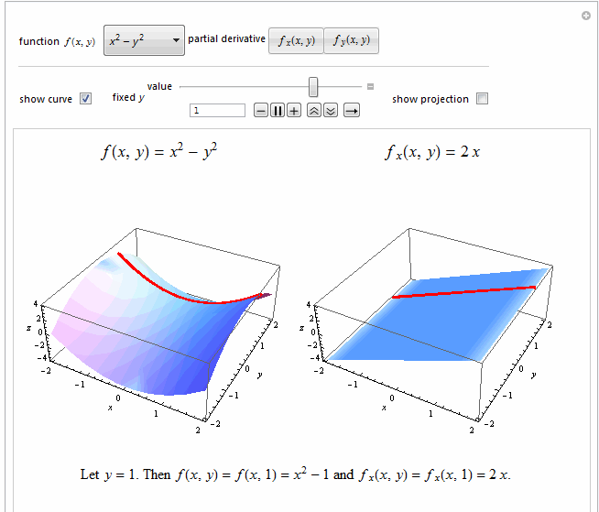
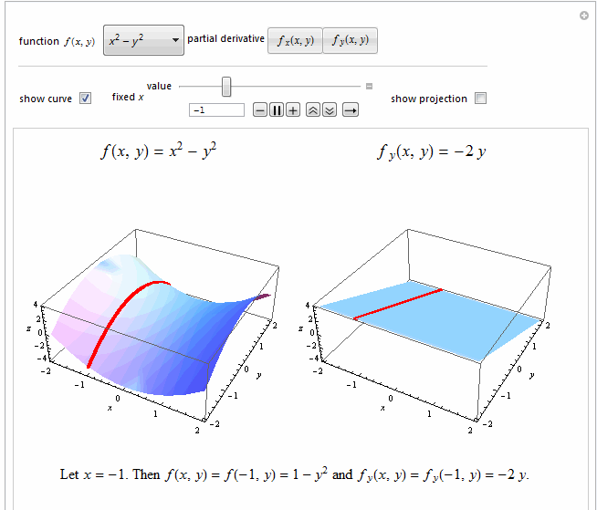

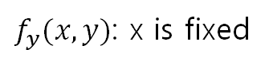
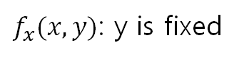
Linear Regression & Backpropagation
Quick review of Partial derivation
$f_{x}(x,y)$: y is fixed
$f_{y}(x,y)$: x is fixed

Slide 7
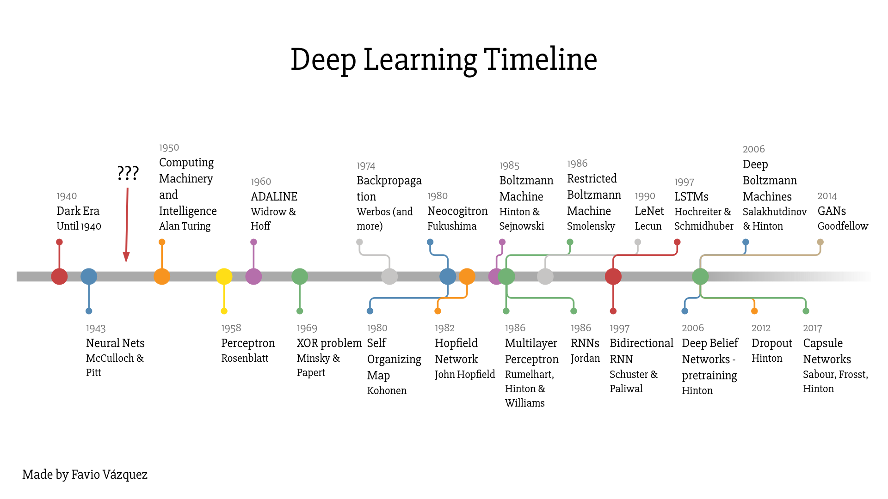
Perceptron & Artificial Neural Networks
Neuron

Slide 8
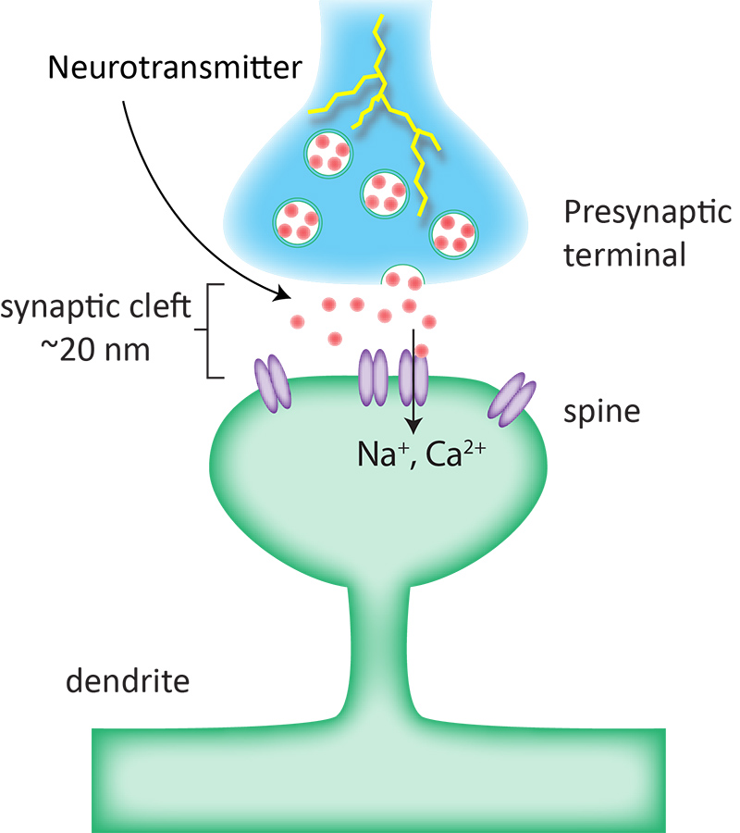
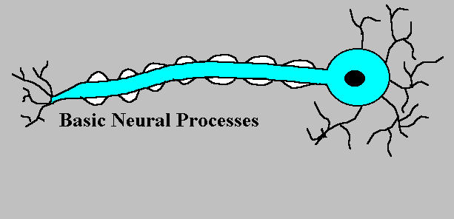
Perceptron & Artificial Neural Networks
Neuron

Slide 9
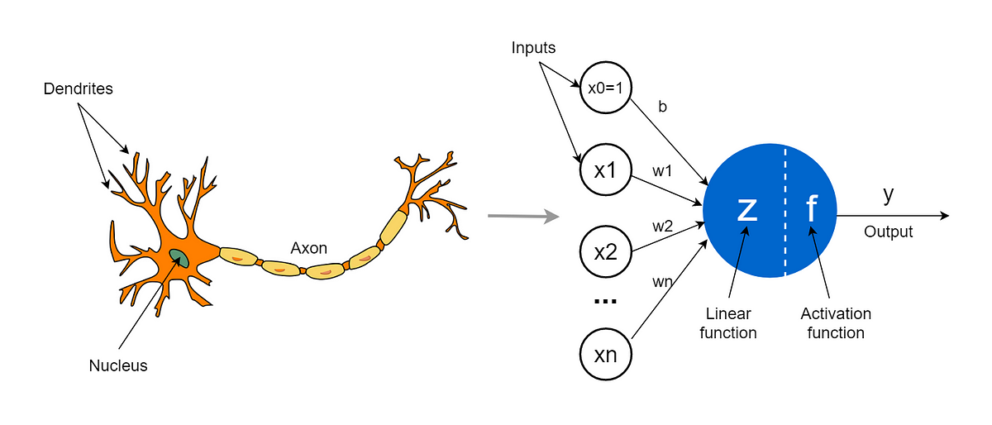
Perceptron & Artificial Neural Networks
Perceptron

Slide 10
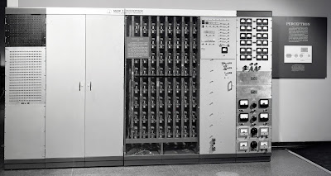
Perceptron & Artificial Neural Networks
The first Perceptron machine
One-Page Schoolhouse: Perceptron (ronkowitz.blogspot.com)

Slide 11
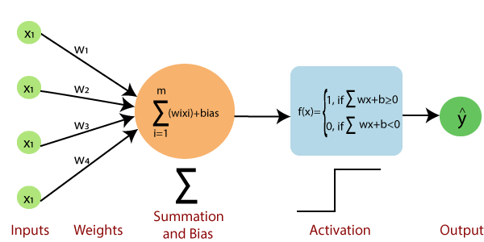
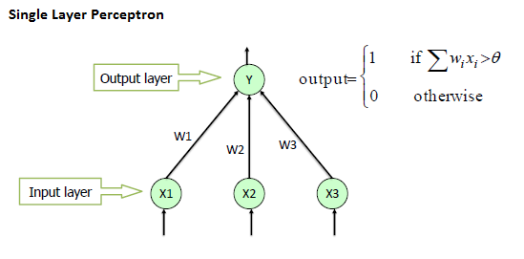
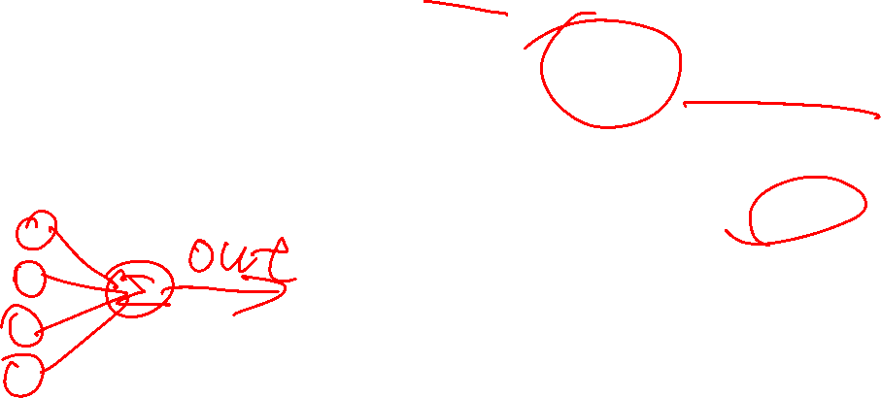
Perceptron & Artificial Neural Networks
Single-Layer Perceptron

Slide 12
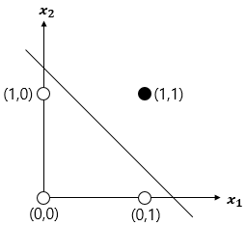
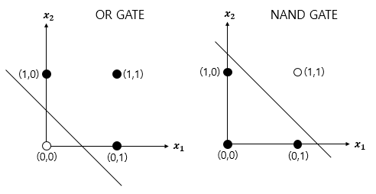
Perceptron & Artificial Neural Networks
Classification using Single-Layer Perceptron
- A perspective of Logic gates
AND gate
No problem occurred

Slide 13
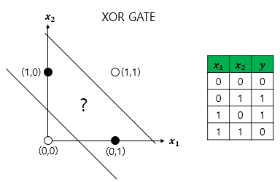
Perceptron & Artificial Neural Networks
Classification using Single-Layer Perceptron
- A perspective of Logic gates
Problem occurred!!!

Slide 14
Perceptron & Artificial Neural Networks
Neuron

Slide 15
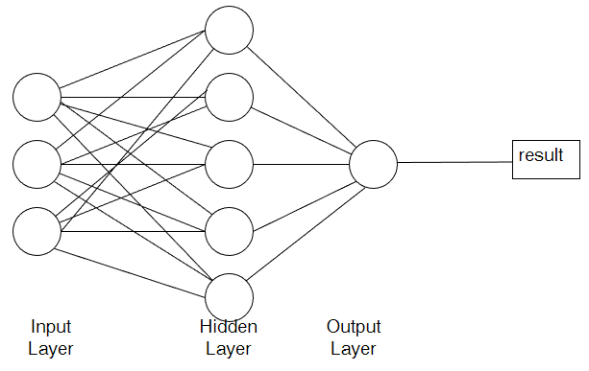
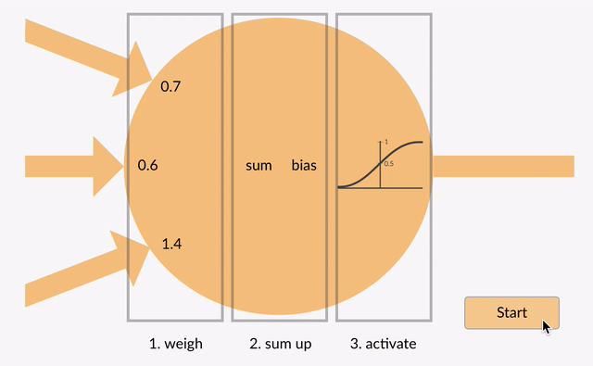
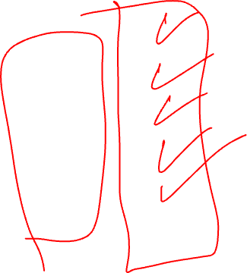
Perceptron & Artificial Neural Networks
Multi-Layer Perceptron (MLP)
Multi-Layer Perceptron
==
Sequentially connected Single Layer Perceptron

Slide 16
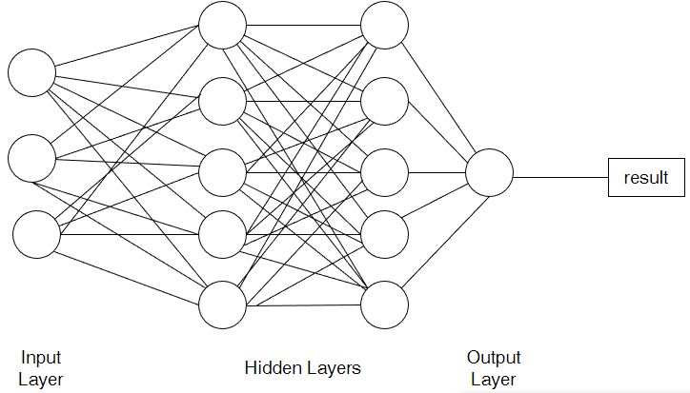

Perceptron & Artificial Neural Networks
Deep Learning?
Deep Learning
==
Training a Deep Neural Network

Slide 17
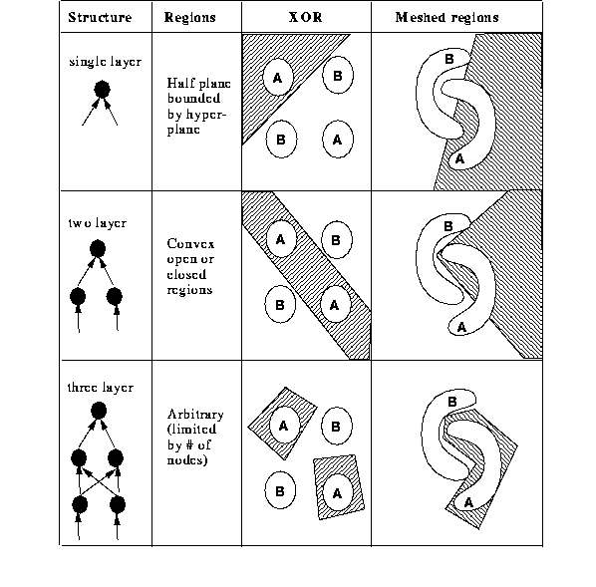
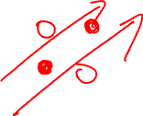
Perceptron & Artificial Neural Networks
Multi-Layer Perceptron (MLP)
Massey University of New Zealand
Artificial Intelligence – Lecture 7 (The XOR problem)

Slide 18
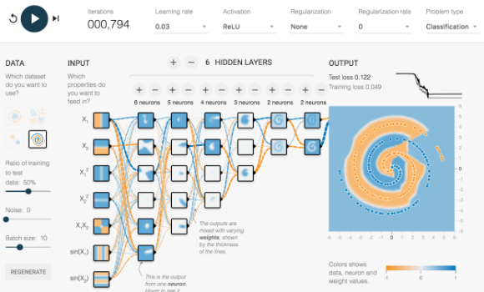
Perceptron & Artificial Neural Networks
Deep Neural Network
A Neural Network Playground (tensorflow.org)

Slide 19
Perceptron & Artificial Neural Networks
Deep Neural Network (DNN)
Sequentially connected Multi-Layer Perceptron
==
Deep Neural Network (DNN)

Slide 20
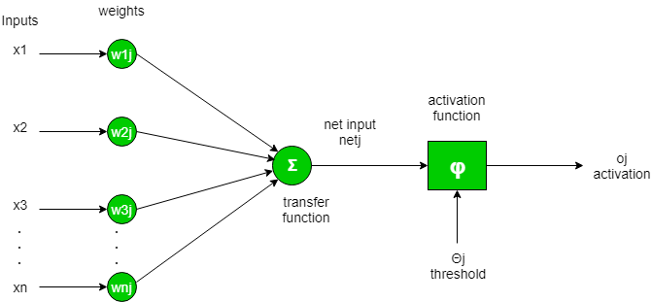
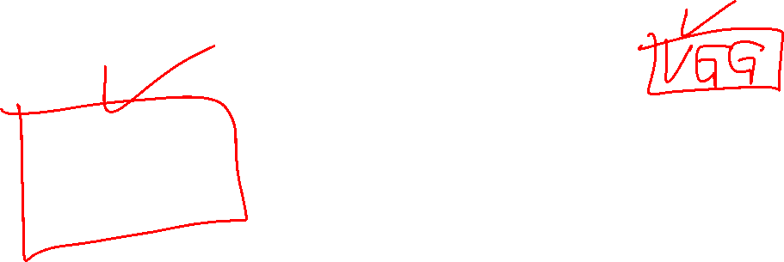
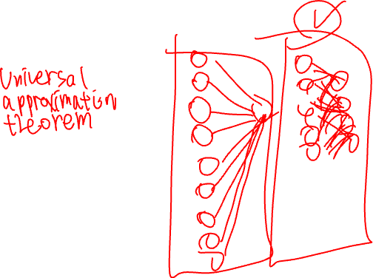
Perceptron & Artificial Neural Networks
Deep Neural Network (DNN)
Structure of Neuron being used in Deep Neural Network
Activation function is included

Slide 21
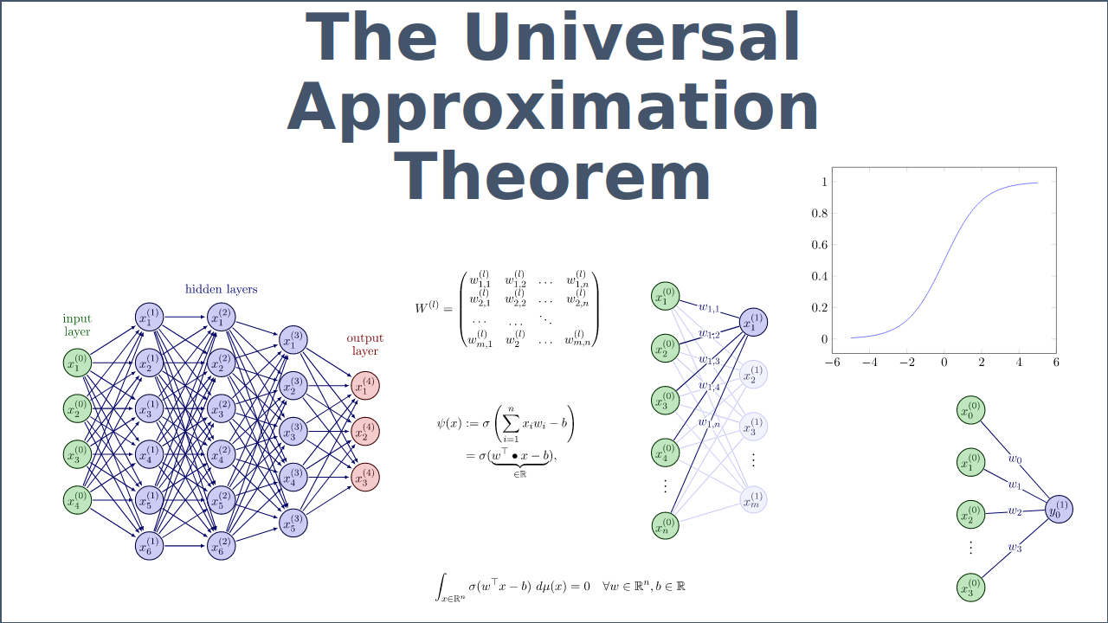
Perceptron & Artificial Neural Networks
Deep Neural Network (DNN)
How does DNN works?
Universal approximation theorem - Wikipedia

Slide 22
Linear Regression & Backpropagation
Backpropagation

Slide 23
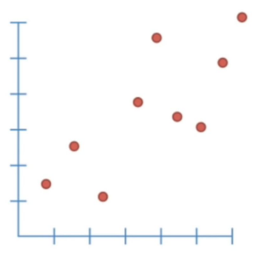
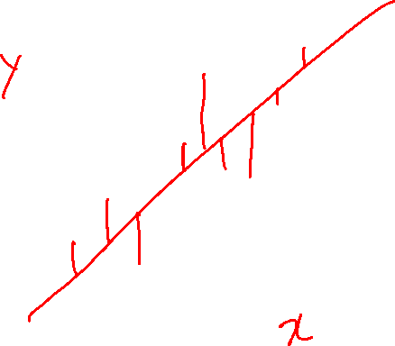
Linear Regression & Backpropagation
Linear Regression
Linear Regression
(also known as least squares)

Slide 24
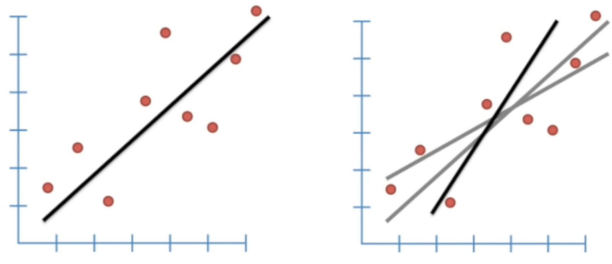
Linear Regression & Backpropagation
Linear Regression
Fitting a line so we can see what the trend is

Slide 25
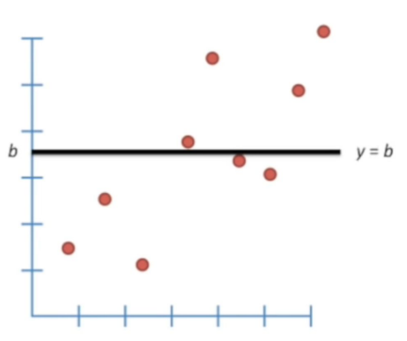
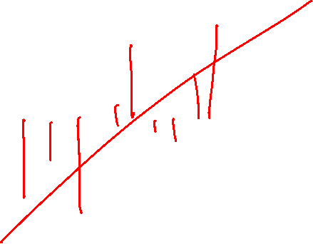
Linear Regression & Backpropagation
Linear Regression
The bad fit
How do we estimate the fitting?

Slide 26
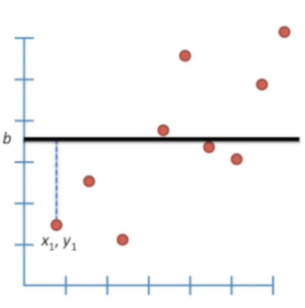
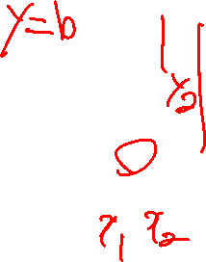
Linear Regression & Backpropagation
Linear Regression
We can measure how well this line fits the data by seeing how close it is to the data points
The distance between the line and 1st data point is b – y1

Slide 27
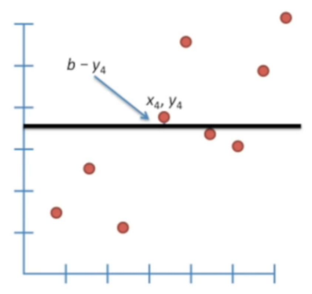
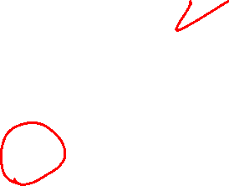
Linear Regression & Backpropagation
Linear Regression
Score = (b-y1) + (b-y2) + (b-y3) + (b-y4)
y4 > b
b-y4 will be negative.
Problem?

Slide 28
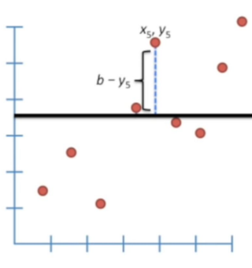
Linear Regression & Backpropagation
Linear Regression
Score = (b-y1) + (b-y2) + (b-y3) + (b-y4) + (b-y5)
Solution?

Slide 29
Linear Regression & Backpropagation
Linear Regression
Score = (b-y1) + (b-y2) + (b-y3) + (b-y4) + (b-y5)
Solution?
Score = |(b-y1)| + |(b-y2)| + |(b-y3)| + |(b-y4)| + |(b-y5)|

Slide 30
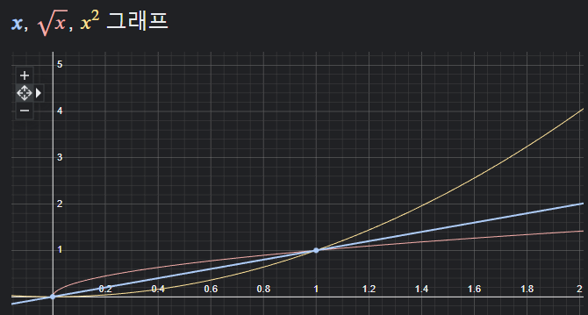
Linear Regression & Backpropagation
Linear Regression
Score = (b-y1) + (b-y2) + (b-y3) + (b-y4) + (b-y5)

Slide 31
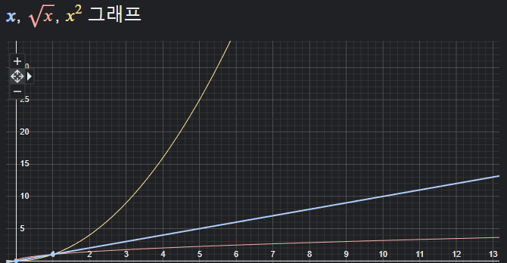
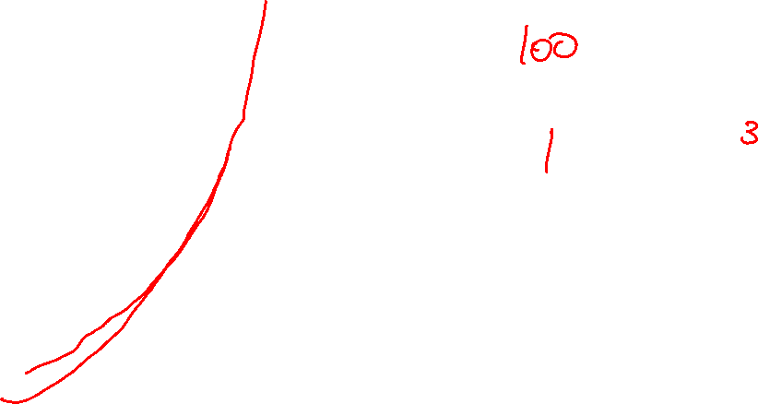
Linear Regression & Backpropagation
Linear Regression
Score = (b-y1) + (b-y2) + (b-y3) + (b-y4) + (b-y5)
Solve this mathematical problem efficiently!

Slide 32
Linear Regression & Backpropagation
Linear Regression
$$Score = (b−y1) + (b−y2) + (b−y3) + (b−y4) + (b−y5)$$
Solve this mathematical problem efficiently!
$Score = {(b−y1)}^{2}+{(b−y2)}^{2}+$ ${(b−y3)}^{2}+ {(b−y4)}^{2}+ {(b−y5)}^{2}$
We can square each term!

Slide 33
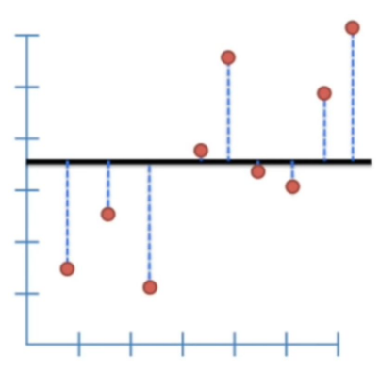
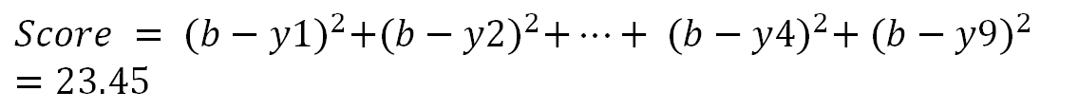
Linear Regression & Backpropagation
Linear Regression Let’s rotate the line a little bit
$$Score = {(b−y1)}^{2}+{(b−y2)}^{2}+…+ {(b−y4)}^{2}+ {(b−y9)}^{2}$$
$$=23.45$$

Slide 34
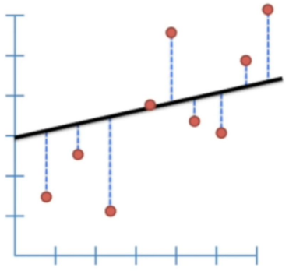
Linear Regression & Backpropagation
Linear Regression Let’s rotate the line a little bit
$$Score = {(b−y1)}^{2}+{(b−y2)}^{2}+…+ {(b−y4)}^{2}+ {(b−y9)}^{2}$$
$$=23.45$$
The better result

Slide 35
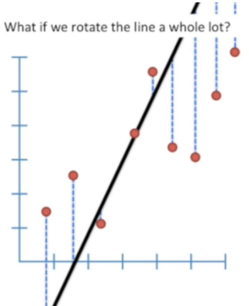


Linear Regression & Backpropagation
Linear Regression What if we rotate too much?
$$Score = {(b−y1)}^{2}+{(b−y2)}^{2}+…+ {(b−y4)}^{2}+ {(b−y9)}^{2}$$
$$=34.56$$

Slide 36



Linear Regression & Backpropagation
Linear Regression Equation expression
Generic line equation: $y=a∗x+b$
Goal: Find optimal values for “a” and “b” so that we minimize the sum of squared residuals

Slide 37


Linear Regression & Backpropagation
Linear Regression Equation expression
Generic line equation: $y=a∗x+b$
Goal: Find optimal values for “a” and “b” so that we minimize the sum of squared residuals
$$Sum of squared residuals= {(\left(a∗x_{1}+b\right)−y_{1})}^{2}+{(\left(a∗x_{2}+b\right)−y_{2})}^{2}+…+{(\left(a∗x_{9}+b\right)−y_{9})}^{2}$$

Slide 38


Linear Regression & Backpropagation
Linear Regression Equation expression
Generic line equation: $y=a∗x+b$
Goal: Find optimal values for “a” and “b” so that we minimize the sum of squared residuals
$$Sum of squared residuals= {(\left(a∗x_{1}+b\right)−y_{1})}^{2}+{(\left(a∗x_{2}+b\right)−y_{2})}^{2}+…+{(\left(a∗x_{9}+b\right)−y_{9})}^{2}$$
$(a∗x_{1}+b)$: The value of the line at $x_{1}$
$y_{1}$: observed value at $x_{1}$
Since we want the line that give us the smallest sum of squares, this methods for finding the best value of “a” and “b” is called “least squares”.

Slide 39


Linear Regression & Backpropagation
Linear Regression Visualization of each rotation

Slide 40


Linear Regression & Backpropagation
Linear Regression Visualization of each rotation
How do we find the optimal rotation for the line?

Slide 41

Linear Regression & Backpropagation
Linear Regression Visualization of each rotation
How do we find the optimal rotation for the line?
Derivatives!

Slide 42

Linear Regression & Backpropagation
Linear Regression Derivative

Slide 43



Linear Regression & Backpropagation
Linear Regression Two independent variables
$$y=a∗x+b$$
We have two independent variables that needs to be optimized
1) $a$: the slope
2) $b$: the intercept

Slide 44


Linear Regression & Backpropagation
Linear Regression If the intercept has fixed?
=> Partial derivative
$$y=a∗x+b$$
We have two independent variables that needs to be optimized
1) $a$: the slope
2) $b$: the intercept

Slide 45

Linear Regression & Backpropagation
Linear Regression Take the derivative for both independent variables
=> Total derivative
$$y=a∗x+b$$
We have two independent variables that needs to be optimized
1) $a$: the slope
2) $b$: the intercept

Slide 46


Linear Regression & Backpropagation
Linear Regression Advanced topic: Gradient Descent

Slide 47


Back to ANN
Deep Neural Network (DNN)
Visualized the loss map of Deep Neural Network

Slide 48



Linear Regression & Backpropagation
Linear Regression Advanced topic: Gradient Descent

Slide 49

Linear Regression & Backpropagation
Linear Regression Advanced topic: Gradient Descent

Slide 50


Linear Regression & Backpropagation
Linear Regression Advanced topic: Backpropagation

Slide 51


Linear Regression & Backpropagation
Linear Regression Advanced topic: Backpropagation
Calculate through the Chain rule!

Slide 52


Recurrent Neural Networks (RNN)
What is RNN?
Normal DNN

Slide 53


Recurrent Neural Networks (RNN)
What is RNN?
Output is calculated sequentially!
(or Recursively)

Slide 54


Recurrent Neural Networks (RNN)
Visualization of RNN
==

Slide 55


Recurrent Neural Networks (RNN)
ETC
Ripple Carry Adder

Slide 56


Recurrent Neural Networks (RNN)
RNN: Examples
One-to-many
Many-to-many
Many-to-many
Ex)
Input: Word
Output: Emotions
Input: Words
Output: Classes
Input: Stock price
Output: Stock price

Slide 57



Recurrent Neural Networks (RNN)
Equations for RNN
$d$: Dimension of the input (vector)
$D_{h}$: Size of the hidden state
$$x_{t}:\left(d×1\right)$$
$$W:\left(D_{h}×d\right)$$
$$W_{h}:\left(D_{h}×D_{h}\right)$$
$$h_{t−1}:\left(D_{h}×1\right)$$
$$b:\left(D_{h}×1\right)$$
Hidden $h_{t}=tanh⁡(W_{x}x_{t}+W_{h}h_{t−1}+b)$
Output $y_{t}=f(W_{y}h_{t}+b)$
$f$ is a nonlinear activation function.

Slide 58



Recurrent Neural Networks (RNN)
Equations for RNN
Batch size: 1
$D_{h}$ and $d$: 4
Visualization of RNN calculation
$d$: Dimension of the input (vector)
$D_{h}$: Size of the hidden state
$$x_{t}:\left(d×1\right)$$
$$W:\left(D_{h}×d\right)$$
$$W_{h}:\left(D_{h}×D_{h}\right)$$
$$h_{t−1}:\left(D_{h}×1\right)$$
$$b:\left(D_{h}×1\right)$$
Hidden $h_{t}=tanh⁡(W_{x}x_{t}+W_{h}h_{t−1}+b)$
Output $y_{t}=f(W_{y}h_{t}+b)$
$f$ is a nonlinear activation function.

Slide 59





Practice: Partial Derivatives for Linear Equations
Equations for RNN
$$y=mx+c$$
$$\frac{∂MSE}{∂m}=\frac{2}{n}\sum{−x_{i}(y_{i}−({mx}_{i}+c)}$$
$$\frac{∂MSE}{∂c}=\frac{2}{n}\sum{− (y_{i}−({mx}_{i}+c)}$$

Slide 60






Practice: Partial Derivatives for Linear Equations
Equations for RNN
$$MSE =\frac{1}{n}\sum{ {(y_{i}−\left({mx}_{i}+c\right))}^{2}}$$
$$y=mx+c$$
$$\frac{∂MSE}{∂m}=\frac{2}{n}\sum{−x_{i}(y_{i}−({mx}_{i}+c)}$$
$$\frac{∂MSE}{∂c}=\frac{2}{n}\sum{− (y_{i}−({mx}_{i}+c)}$$
Problem
(x1, y1) = (1, 2)
(x2, y2) = (2, 3)
(x3, y3) = (3, 4)
Initial condition
m:1, c:0
$$y=x$$
Learning rate = 0.01

Slide 61







Practice: Partial Derivatives for Linear Equations
Equations for RNN
$$MSE =\frac{1}{n}\sum{ {(y_{i}−\left({mx}_{i}+c\right))}^{2}}$$
$$y=mx+c$$
$$\frac{∂MSE}{∂m}=\frac{2}{n}\sum{−x_{i}(y_{i}−({mx}_{i}+c)}$$
Initial condition
m:1, c:0
$$y=x$$
$$\frac{∂MSE}{∂c}=\frac{2}{n}\sum{− (y_{i}−({mx}_{i}+c)}$$
Problem
(x1, y1) = (1, 2)
(x2, y2) = (2, 3)
(x3, y3) = (3, 4)
$$MSE =\frac{1}{3}\left[{\left(2−1\right)}^{2}+{\left(3−2\right)}^{2}+{\left(4−3\right)}^{2}\right]=1$$
$$\frac{∂MSE}{∂m}=\frac{2}{3}\left[−1\left(2−1\right)−2\left(3−2\right)−3(4−3)\right]=−2$$
$$\frac{∂MSE}{∂m}=\frac{2}{3}\left[−\left(2−1\right)−\left(3−2\right)−\left(4−3\right)\right]=−2$$

Slide 62
References
https://youtube.com/playlist?list=PLblh5JKOoLUIzaEkCLIUxQFjPIlapw8nU
Section 01 (massey.ac.nz)

